Slide 1


Problem Statement Number : PS02
Team Name : Error 404
Team Number: HS107
College Name: RSCOE / MMCOE
HackerSprint

Slide 2
Problem Statement
Commodity Price Forecasting.
INFO : - Commodity price forecasting: use multivariate techniques to forecast
future prices of steel, oil, etc using economic parameters. Any one commodity considered is fine too.
Solution Overview.
Forecasting Of commodity Over time Period can be Done Using
Machine Learning & Deep Learning Specifically .
Best Part About The statistics is we can
Predict Them Find Patterns , ML Algos’
Like RNN - LSTM can Successfully Forecast
And Predict the price.
Need of Problem statement
There is an increasing interest in predicting markets among economists, policymakers, academics and market makers. Sudden growth and fall of the Market is Being too Often these days. The objective of the proposed work is to study and improve the algorithms to forecast the prices of commodity.

Slide 3
“Data is the new OIL”
“Data Will talk to you if you are willing to Listening”
Dataset we are using for the Project is 2021’s Recent International Stock
Exchange Metals and Crude Oils Fetched From www.macrotrends.ne

Slide 4
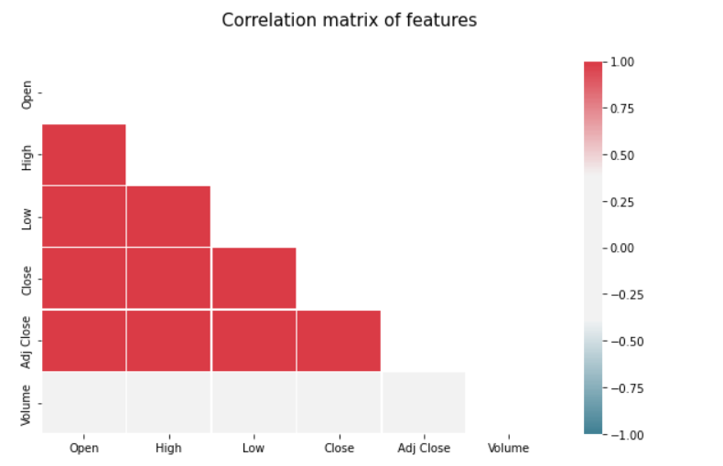
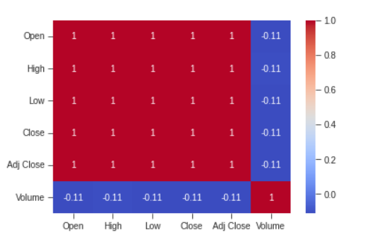
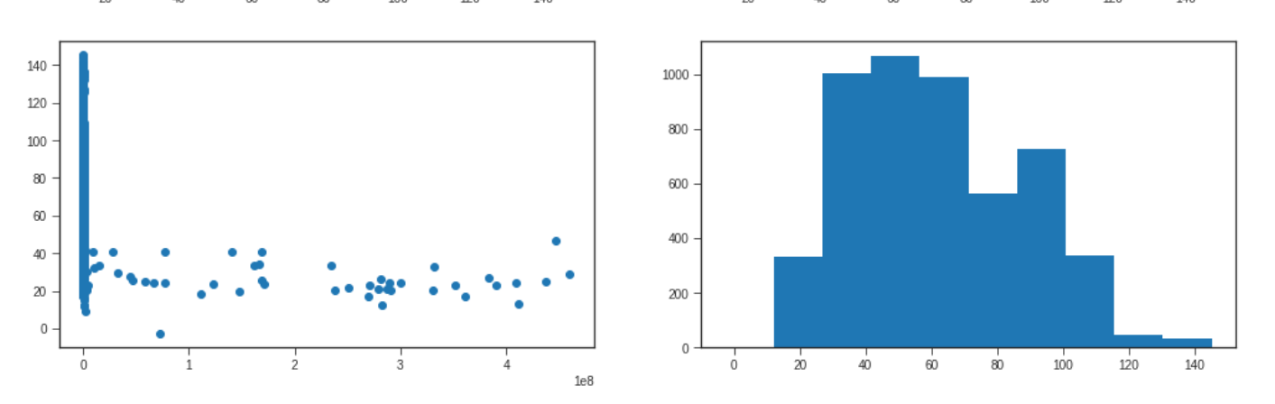
Volume vs Close
Closing price

Slide 5
Models To be Used
SVM (Regression) : -
SVM to find the patterns in N-dim Hyperplane
Accuracy : 92.45%
Random Forest Regressor
Random forest is a great algorithm to train early in the model development process
Accuracy : 93.08
S
R
To check the Dependency on the model.
Model Evaluation
Best fit Model for Forecasting Problems Having neuron with both long and short term memory
LSTM Accuracy : 88.14 (Rmse:2.13)
E
L

Slide 6
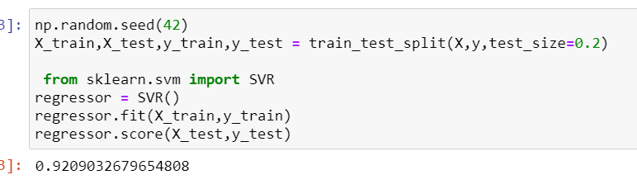
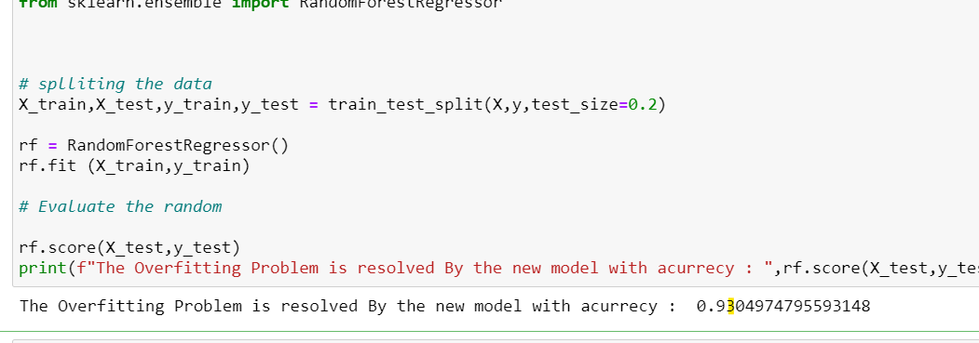
Results
SVM regression
Random Forest

Slide 7
ROADMAP FOR THE SOLUTION
Analyzing And Cleaning Data
Applying The Machine Learning Models For Predictions
Making REquired Changes
As Per the Mentor
1
3
5
2
4
6
Visualization Of
the Data
Evaluating Models Using MSE MAE RMSE R^2
Forecasting Steel and Oil Price Prediction

Slide 8
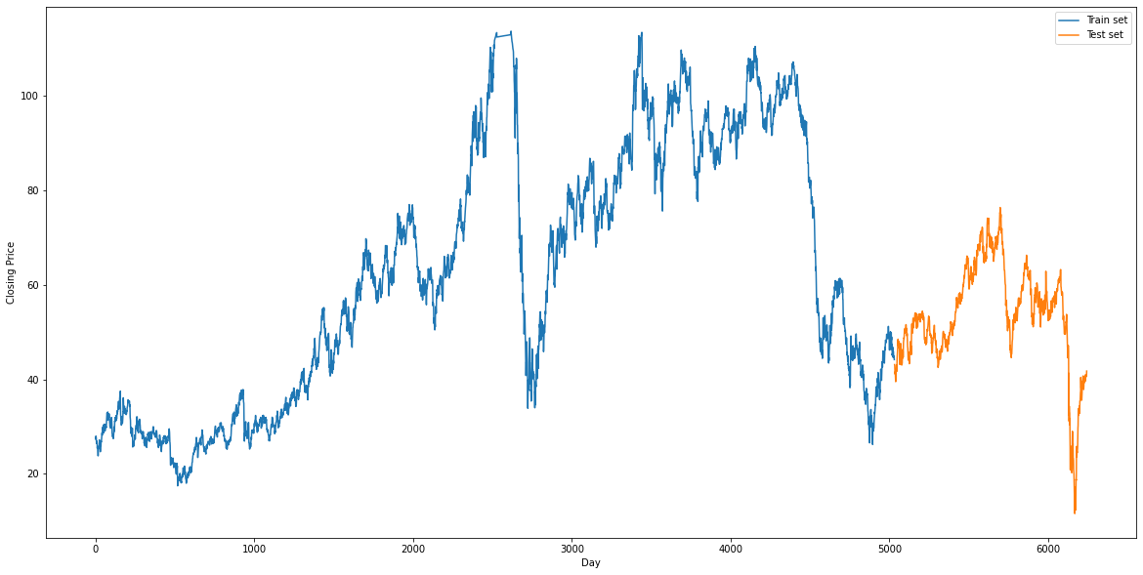
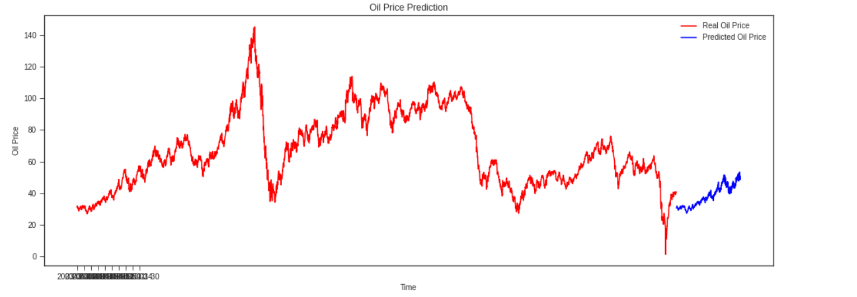
Performing LSTM on Time Series Data
Current Model Only Predicts Data Over A period of 30 days at an Accuracy of 88.14.%
Why LSTM...??

Slide 9
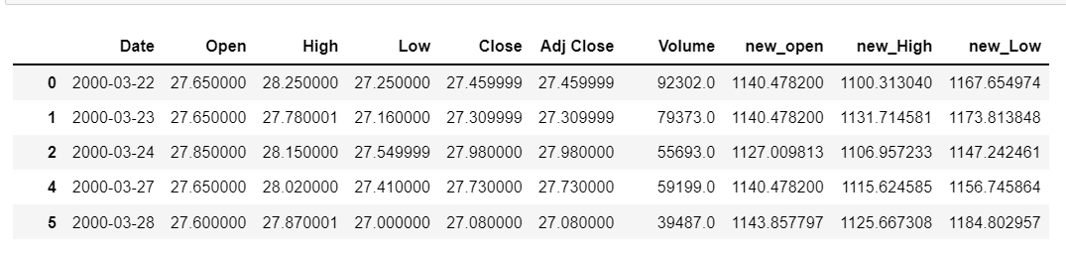
Approach for Segregating Data
As we find The values to close they are useless...as they dont give any useful information
We find Mean - Root Method Musch Flexible As we have to keep the Project simple And PCA is already Implemented For This We Actually Find The Mean Of Dominant Factors then Subtracted themform original

Slide 10
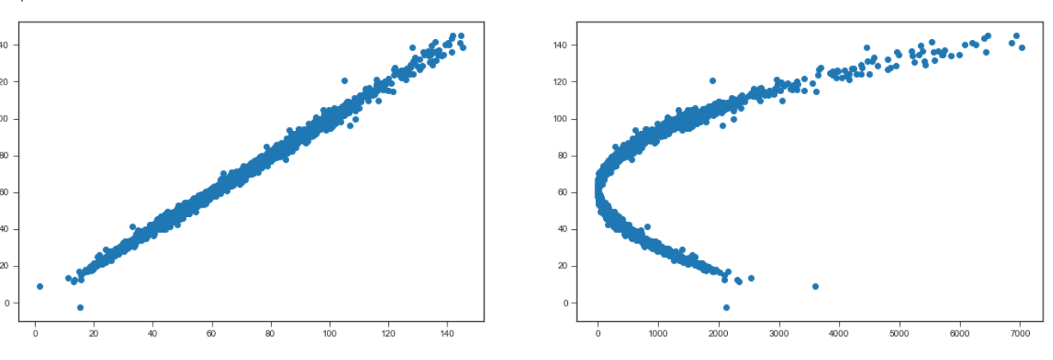
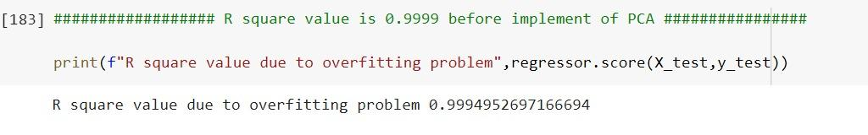
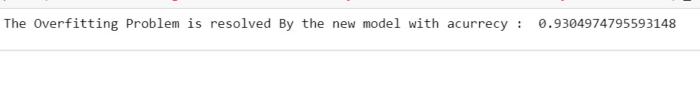
Next Part
Now as we have Amplified the differences we find following observations

Slide 11
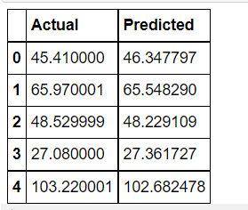
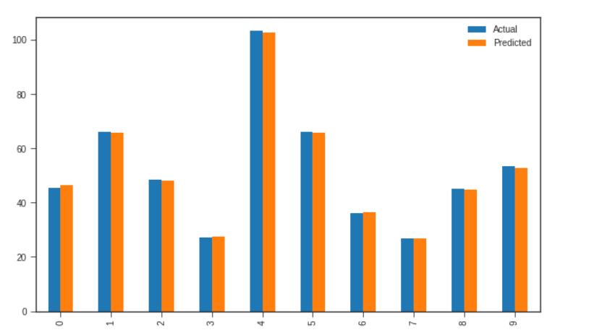
OutPut
From The Above Image we Conclude That The Price For the next 20 days can be predicted using This machine learning Model

